Slide 1

CS 533 INTRO TO DATA SCIENCE
Michael Ekstrand

Slide 2
PROBABILITY AND INFERENCE

Slide 3
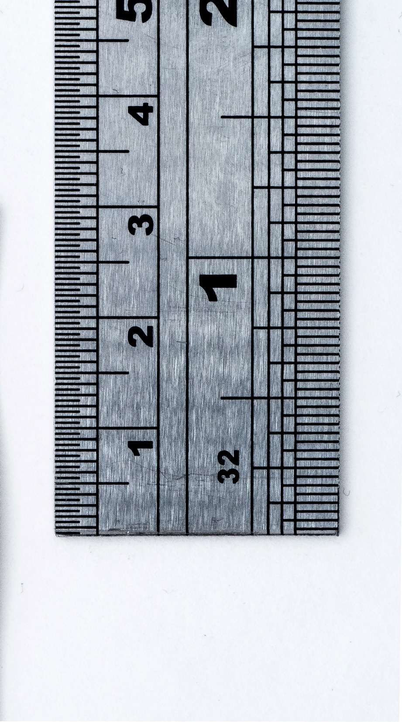
Learning Outcomes (Week)
Understand probability notation
Express formulas with probability notation
Understand the difference between estimation and testing
Compute confidence intervals and other estimates of the precision and significance of an effect
Photo by William Warby on Unsplash

Slide 4
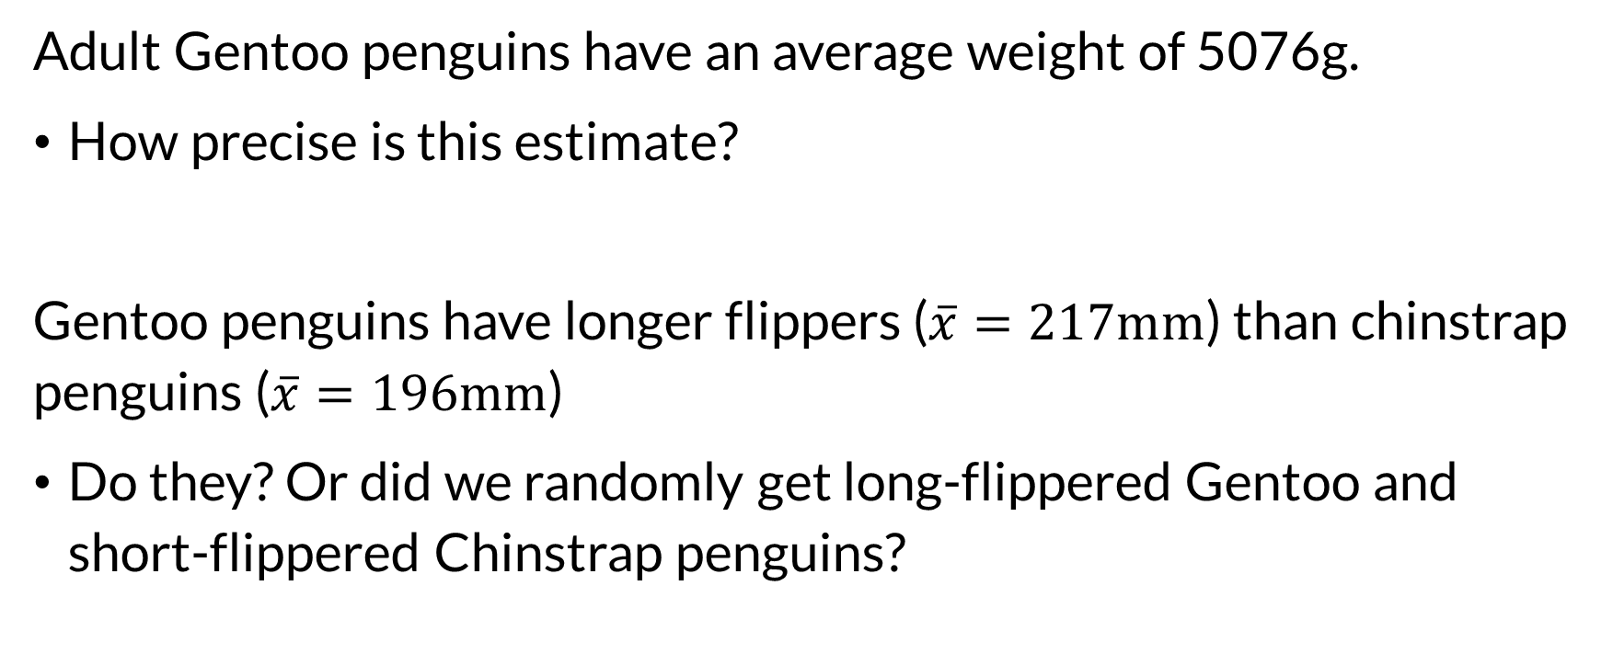
Statistics
Adult Gentoo penguins have an average weight of 5076g.
How precise is this estimate?
Gentoo penguins have longer flippers ($\overline{x}=217mm$) than chinstrap penguins ($\overline{x}=196mm$)
Do they? Or did we randomly get long-flippered Gentoo and short-flippered Chinstrap penguins?

Slide 5
Inference
Inference is learning about data.
Estimating the value of a parameter
Testing the data’s support for an hypothesis

Slide 6
Estimates
An estimate is an estimated value of some underlying quantity
Often has a confidence interval or similar (e.g. credible interval)
An estimator is a procedure for computing an estimate.
An estimand is a thing we try to estimate.
Often use a statistic from a sample to estimate a parameter, which is the estimand.

Slide 7
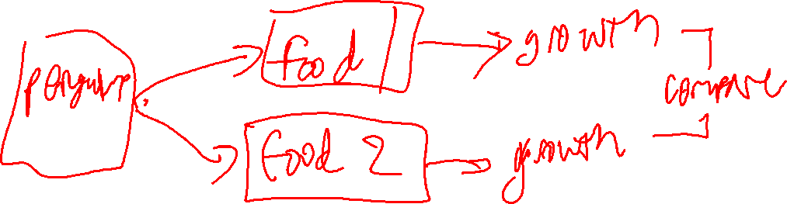
Effect Size
The effect size is the size of the difference between two groups or treatments.

Slide 8
Perspective
Few bright-line rules – multiple pieces of evidence increase confidence
Probability is meaningful even without a random process – can quantify degrees of belief
Effect size and estimates are usually more important than hypothesis tests (but I’ll teach those anyway)

Slide 9

Wrapping Up
We’re going to move beyond computing and comparing statistics to reasoning about their impact and implications.
The foundations of this will be probability theory.
Photo by Celpax on Unsplash

